Slide 1
Wisdom Healing Qigong
Eight week class results
Chronic Pain
Well-being / Global Distress
Including Depression / Anxiety

Slide 2
What is Wisdom Healing Qigong?
Wisdom Healing Qigong (chee-gung) is a system of healing and transformation for optimizing health & wellness. Using gentle movement, sounds, visualization & meditation, the mind & body are empowered with more vitality & joy.
WHQ was developed by Dr. Pang Ming, founder of the largest Qigong hospital in China, and is taught worldwide by Master Mingtong Gu.
Protocol for eight week WHQ class was created by Master Mingtong Gu and taught by Ilka de Gast, PsyD. (currently in WHQ Teacher Training Program).

Slide 3
Eight week WHQ class June 10 – August 5, 2015
15 patients started the class (class ended with 12 patients).
7 patients presented with chronic pain.
12 patients presented with depression and / or anxiety.
Patients completed two self-report questionnaires before class on June 10 (or June 17).
Patients completed two self-report questionnaires at the end of each class from June 10 – August 5.
Self-report questionnaires focused on chronic pain, well-being / global distress, including depression and anxiety and a general description of symptoms.

Slide 4
Results
Graphs showing changes in:
Chronic Pain levels
Well-being / Global Distress Scores
Including Depression and Anxiety

Slide 5
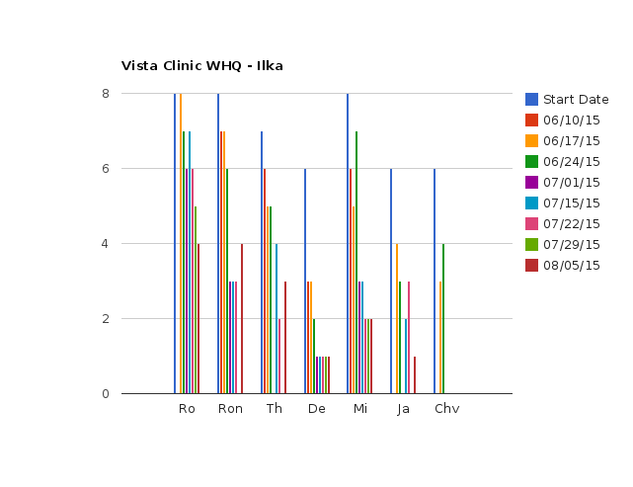
Chronic Pain (10 – worst pain / 1 – no pain) How would you rate your pain right now?

Slide 6
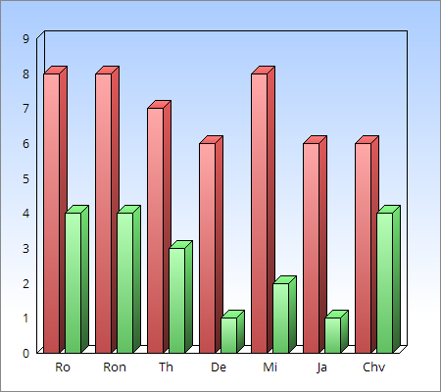
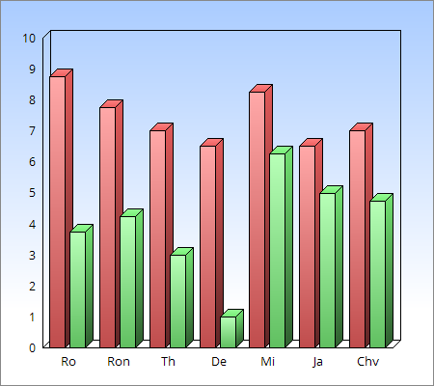
Chronic pain red – pain rating on 6/10/15 green – pain rating on 8/5/15
Pain right now
Global pain score

Slide 7
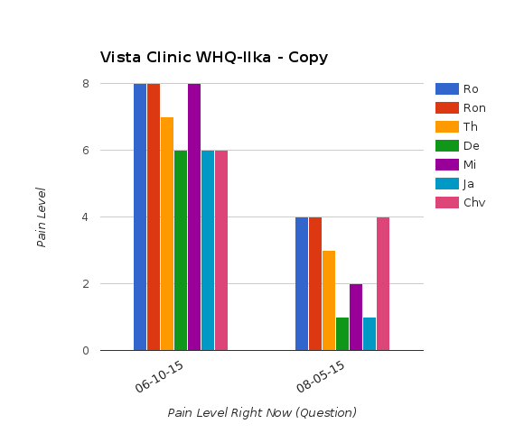
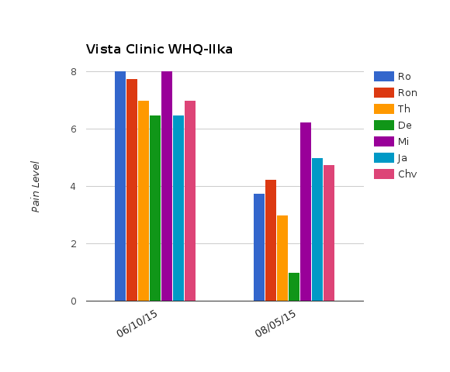
Chronic Pain
Pain right now
Global pain score

Slide 8
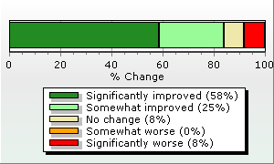
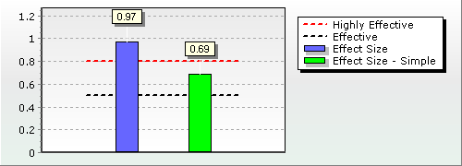
Change in Well-being and Global Distress scores including Depression and Anxiety
Distribution of Patient Change
Effect Size - Severity Adjusted: 0.97
and Simple: 0.69
Note: Severity Adjusted Effect Size and Distribution of Patient Change graphs are based on cases with intake scores in the clinical range with 2 or more assessments. The sample size for these graphs is 12 cases, which is 100.00 % of all cases with multiple assessments.

Slide 9
Change in Well-being and Global Distress scores over the last three weeks of class
7/22/15 – 67% improvement (46% significant improvement)
7/29/15 – 77% improvement (62% significant improvement)
8/5/15 – 83% improvement (58% significant improvement)

Slide 10
Results
Quotes from patients

Slide 11
Quotes
Woman with HIV, anxiety and headaches:
“Feeling relaxed, peace of mind, headache relieved.”
Man with HIV, depression and chronic pain:
“Shoulder and back pain have subsided, my energy is more fluid.”
Woman with depression and chronic pain
“Embraced the pain in my body – which released my tension.” “Conflicts of emotions eased.”
“Feeling a sense of calmness and joy.”
Man with HIV, anxiety and chronic pain:
“Back pain is minimal, emotional state is joyful.”
“Back pain is better, forgiveness of self has improved.”
“When I have elbow pain I don't resist it. I follow it and smile at it.”
15 year old girl with depression, ADHD and “emotional eating issues”:
“I feel as if the darkness in my body is fading like if my anger was disappearing.”
Last class:
“Today I had knee pain and it went away as soon as we did the Bending Spine practice. I feel connected with my body. I've learned to accept all good and bad in my body and I feel amazing.”

Slide 12
Quotes
Man with anxiety and depression:
“Release of sadness, feel calmness, aliveness.”
Man with HIV, depression and ADHD:
“My mind is more clear, more focused.”
Woman with Parkinson's:
“I have improved willingness to confront my Parkinson's.”
Woman with depression and chronic pain:
“My body feels warm and fuzzy all over, tingly – I feel good.”
Man with HIV and depression:
“Brought up emotion to the point of tears.”
Woman with depression, anxiety and chronic pain:
“My body feels more alive and lighter, I don't feel as anxious.”
“When I came in my upper back and lower back were hurting bad, I have no pain now.”

